Slide 1
A Model for Building the
Early Care Workforce
Child Development Pathway Consortium:
Laurie Nalepa Marni Roosevelt Nona Matatova

Slide 2


Los Angeles
Valley College
Over 19,000 students
Ethnically diverse
Majority on financial aid

Slide 3


LAVC Child Development Department
1,750 students enrolled
AA-degree with 5 options
6 occupational/skills certificates available

Slide 4
“Studies show that children in early education programs are more likely to score higher in reading and math, more likely to graduate from high school and attend college, more likely to hold a job, and more likely to earn more in that job. For every dollar we invest in these programs, we get nearly $10 back in reduced welfare rolls, fewer health care costs, and less crime.”
-President Barack Obama, March 10, 2009
The Importance of Early Education

Slide 5




Challenges in the field of Early Education
High demand for infant/toddler care
Lack of consistent training in the field
Early Childhood Education
Poor wages, lack of benefits
High turnover rate

Slide 6

Challenges in California
4 million children with working parents
46% increase in # of jobs to be filled
Early Childhood Education

Slide 7

Challenges in Los Angeles
1 million children with working parents
Licensed childcare supply meets 21% of the need
Childcare workers and preschool teachers are severely underpaid
Early Childhood Education

Slide 8

What is the Early Care Workforce?
It’s more than just teachers

Slide 9

Entry Into the Early Care Workforce
Enter the career ladder with just
units of child development coursework…
6
Additional courses move you up the ladder to higher paying jobs.

Slide 10
With 6-24 units…
Social & Human Service Assistant
$34,776
Para-educator
$29,973
Preschool Classroom Assistant
$20,800

Slide 11
With an AA/BA degree…
Public School Special Education Teacher
$62,092
Physical Therapist
Assistant
$56,912
ECE Administrator
$45,709
Social Service Specialist
$36,681

Slide 12
With a MA/MS/PhD…
Occupational Therapist
$85,206
Speech Language Pathologist
$81,451
Physical Therapist
$79,223

Slide 13


LAVC Strategic Initiatives
Increase Incumbent Workforce Skills
Increase Access
Enhance Student Success
Improve Retention
Increase Existing Workforce Skills
Provide College Faculty Development
Identify Career Pathways
Provide High School Professional Development
Articulation Agreements

Slide 14
The 7- Step Model
1
2
3
Identify Your
Partners
Determine
Needs
Identify
Linkages
4
5
6
7
New or Existing
Projects
Find Funding
Create and
Implement
Projects
Evaluate

Slide 15
Identify Your Partners
The 7- Step Model
1

Slide 16
Determine Needs
The 7- Step Model
2

Slide 17
Identify Linkages
The 7- Step Model
3

Slide 18
New or Existing Projects
The 7- Step Model
4

Slide 19
Find Funding
The 7- Step Model
5

Slide 20
Create and Implement Programs
The 7- Step Model
6

Slide 21
Evaluate
The 7- Step Model
7

Slide 22



Child Development Pathway Consortium (CDPC)
Los Angeles Valley College
Tech Prep Consortium

Slide 23
Program Overview
CDPC was designed to increase the pipeline of future early care workers
Develop academic pathways and support systems for these workers to get there
Our model includes…
Recruiting/outreach to 500 students from 3 high schools
Engaging 55 students in CTSO/FHA-HERO affiliated clubs
Work-based learning and internships for 25 students
Child Development Pathway Consortium

Slide 24
Step 1 – Partners
Child Development Pathway Consortium

Slide 25
Step 2 – Determine Needs
Child Development Pathway Consortium

Slide 26
Step 3 – Identify Linkages
Child Development Pathway Consortium

Slide 27
Step 4 – Create New Project
Project | Increase Access | Improve Retention | Incumbent Skills | Skill Develop. | ID Career Pathways | HS Prof Dev | College Faculty Dev | Enhance Student Success | Artic. Agree.
P-CAT |  |  | ✔ | ✔ | ✔
HIGH5 | ✔ | ✔ |  |  | ✔ | ✔ |  | ✔
CAST | ✔ | ✔ |  |  | ✔ |  |  | ✔
CD COMPASS | ✔ | ✔ | ✔ |  | ✔ | ✔ | ✔ | ✔
Perkins IV |  | ✔ |  | ✔ |  | ✔
Mentor Program |  |  | ✔ | ✔ |  |  | ✔ | ✔
CDTC | ✔
Child Development Pathway Consortium

Slide 28
Step 4 – Create New Project
Project | Increase Access | Improve Retention | Incumbent Skills | Skill Develop. | ID Career Pathways | HS Prof Dev | College Faculty Dev | Enhance Student Success | Artic. Agree.
P-CAT |  |  | ✔ | ✔ | ✔
HIGH5 | ✔ | ✔ |  |  | ✔ | ✔ |  | ✔
CAST | ✔ | ✔ |  |  | ✔ |  |  | ✔
CD COMPASS | ✔ | ✔ | ✔ |  | ✔ | ✔ | ✔ | ✔
Perkins IV |  | ✔ |  | ✔ |  | ✔
Mentor Program |  |  | ✔ | ✔ |  |  | ✔ | ✔
CDTC | ✔
CDPC | ✔ | ✔ |  | ✔ | ✔ | ✔ |  | ✔ | ✔
Child Development Pathway Consortium

Slide 29


Step 5 – Find Funding
If only money really did fall from the sky…
Or, grew on trees!
Child Development Pathway Consortium

Slide 30
Step 6 – Implementation
Pathways
Pipeline
Child Development Pathway Consortium

Slide 31

Step 6 – Implementation
Articulation – What does it mean?
Create an agreement between a HS and a Community College that lays out equivalency, dual credits and policies for the articulated programs.

Slide 32

Step 6 – Implementation
Articulation – Why should we do it?
Students earn college credit for courses taken at HS
Increases likelihood of going to college
Reduces drop-out rate
Eliminates course duplication
Reduces the cost of education for students and state

Slide 33
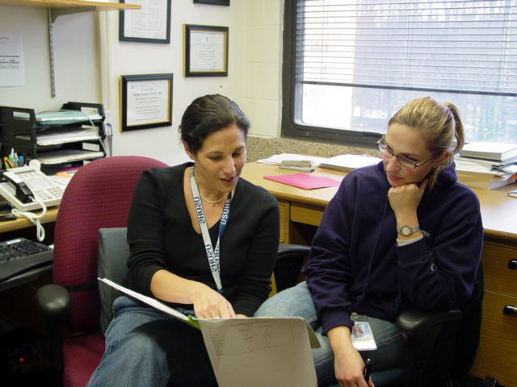
Step 6 – Implementation
Articulation – How to do it…
HS and Community College faculty work on aligning the curriculum
When it is approved by the HS and Community College, HS students take the designated class at the HS during the school year

Slide 34
Step 6 – Implementation
Classes – LAVC Example

Slide 35
Step 6 – Implementation
Student Support
Students enrolled in articulated courses with LAVC will also have access to all campus student services, including free tutoring services, access to the Health Center, and computer labs.

Slide 36

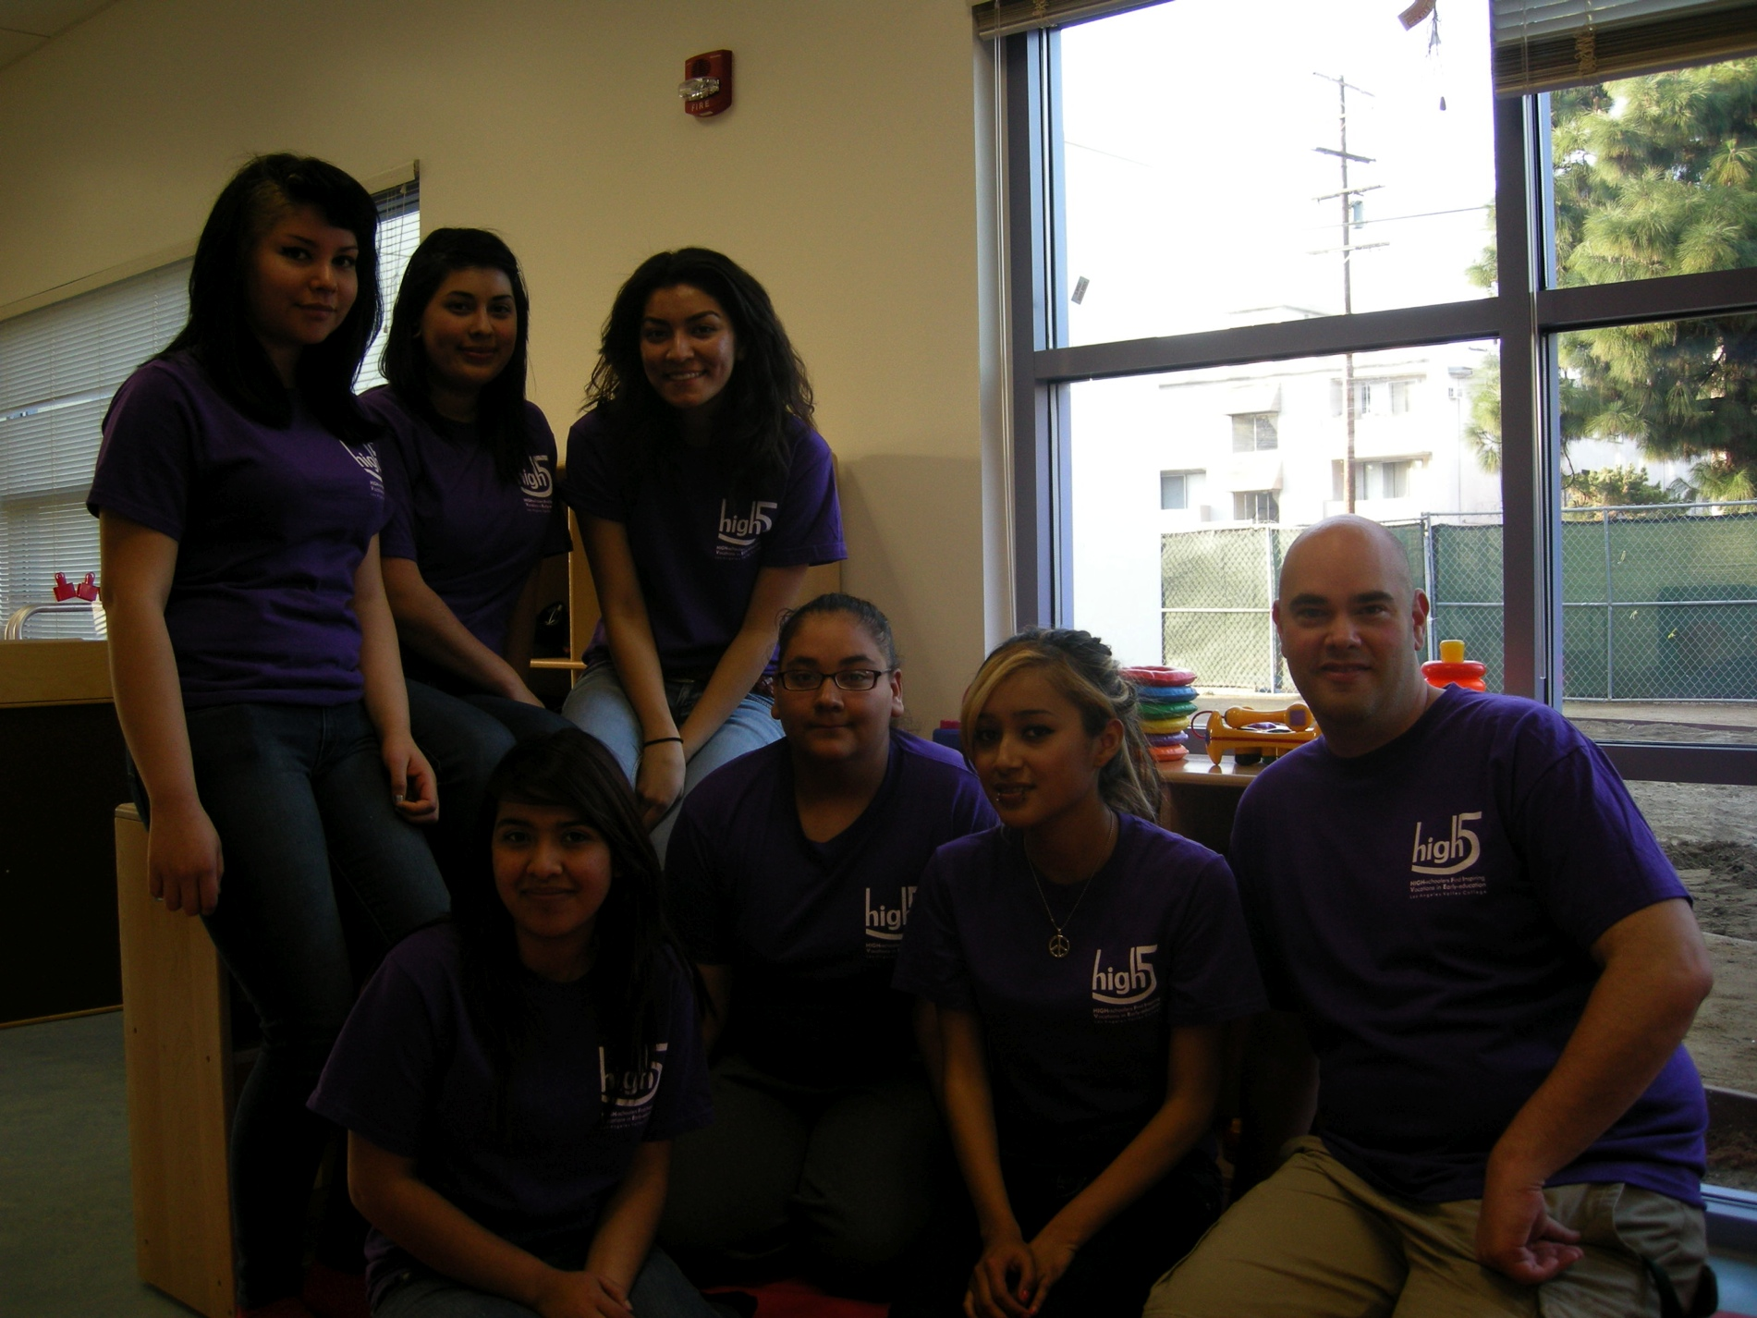
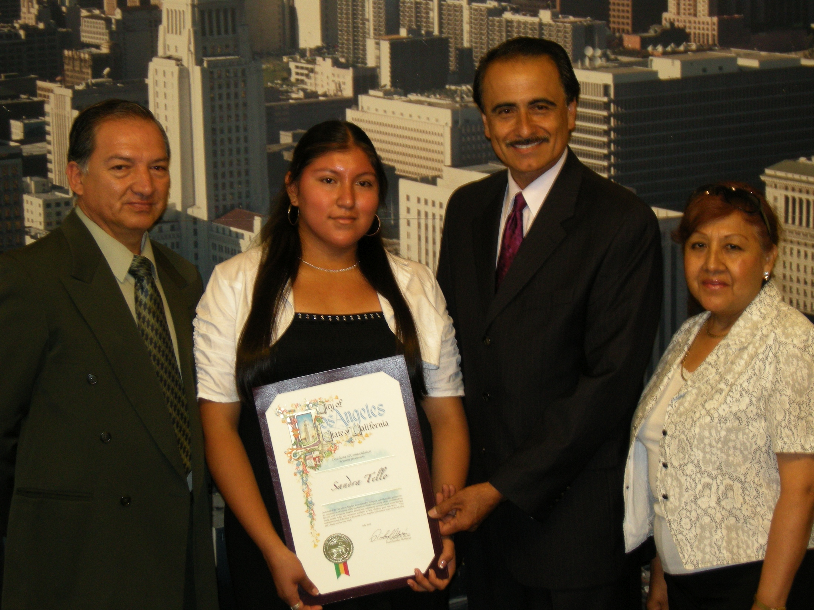
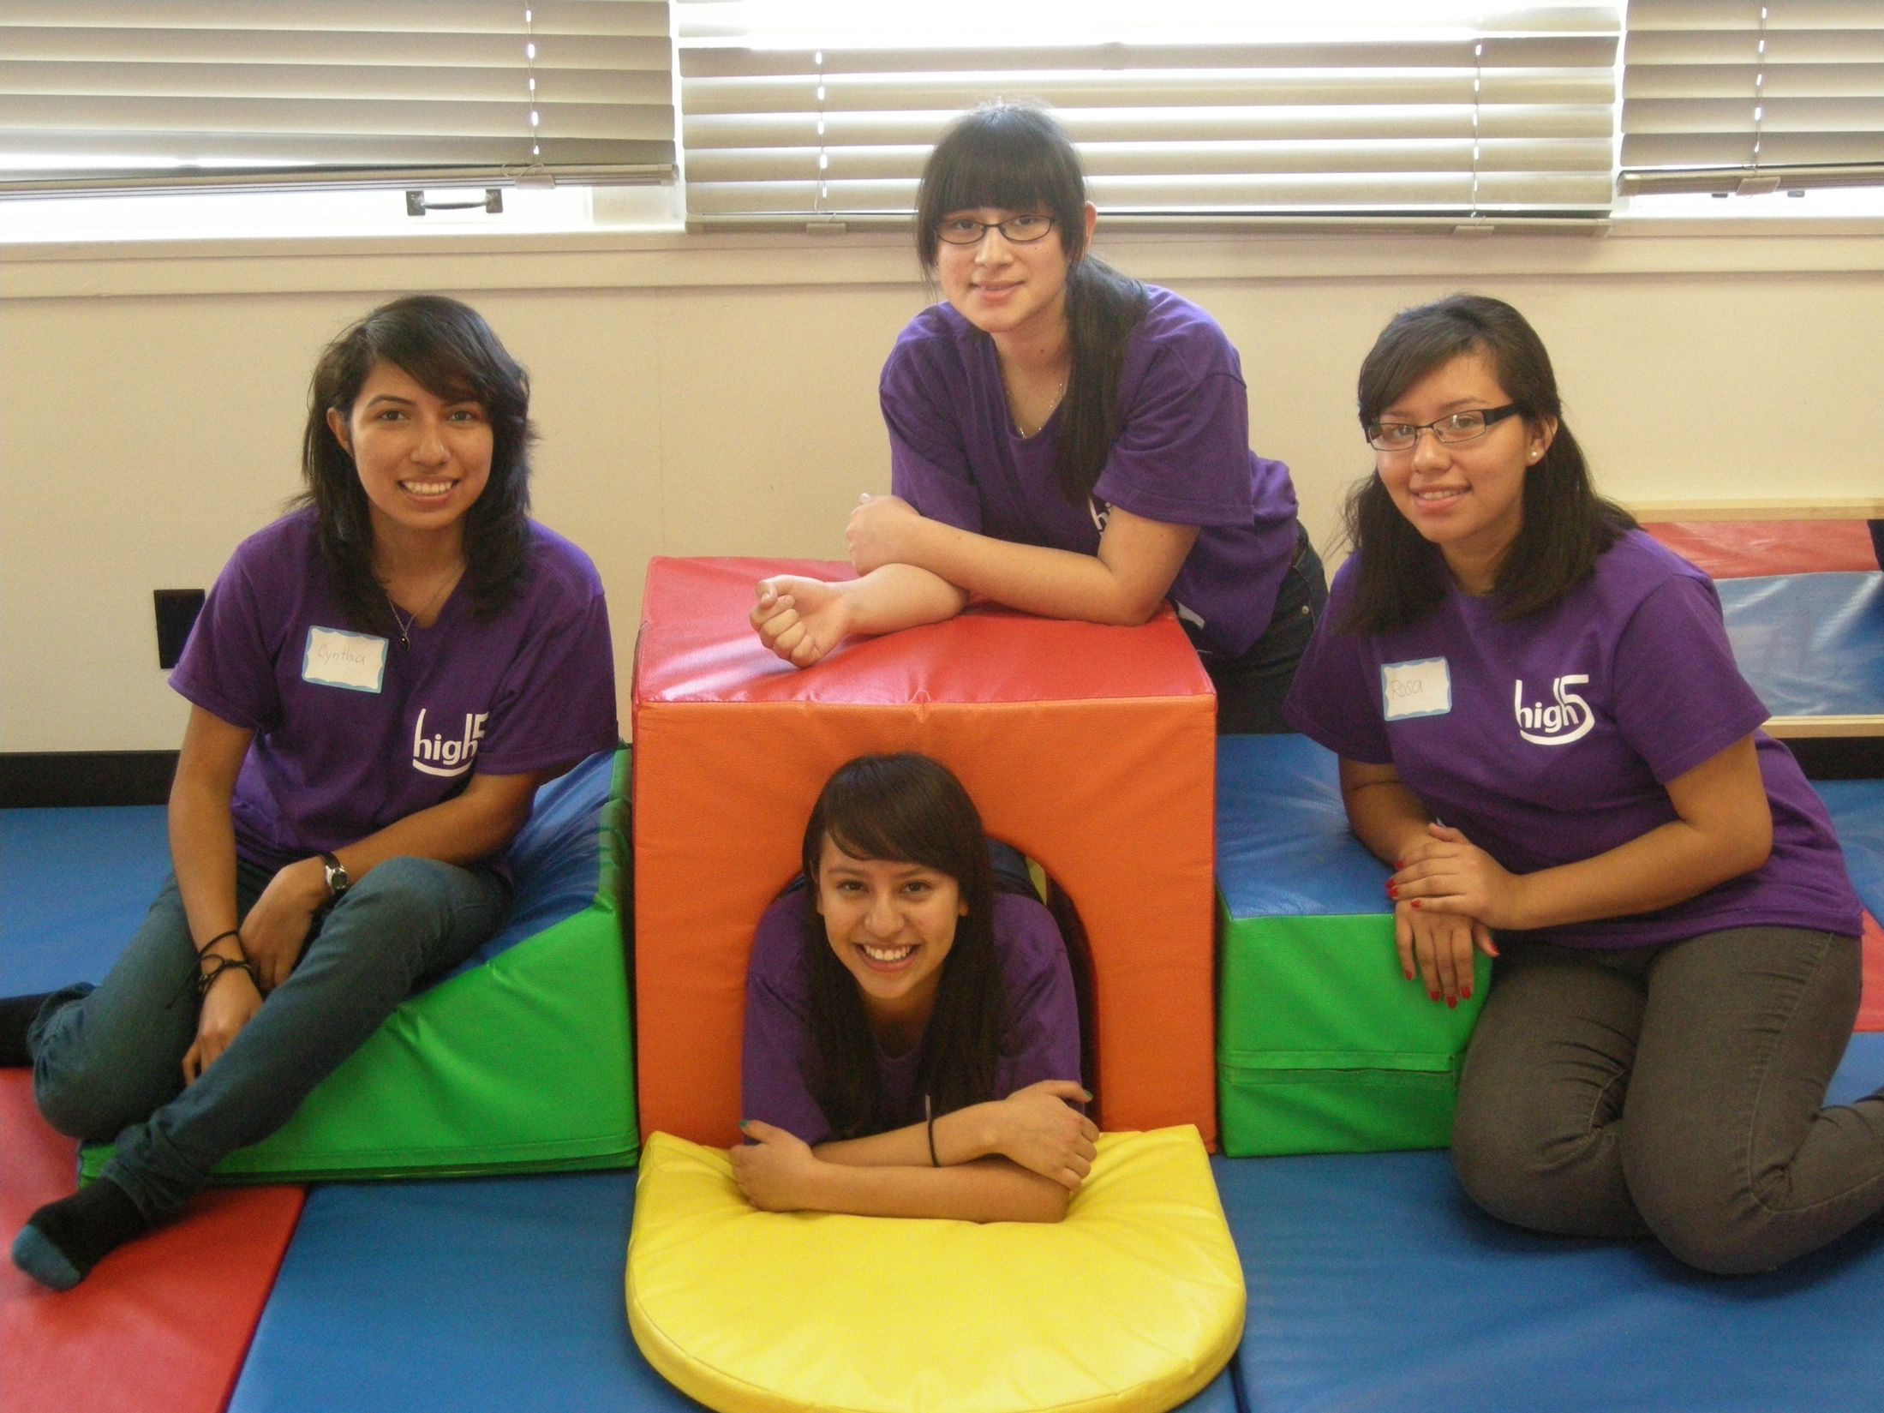

Step 6 – Implementation
Clubs

Slide 37
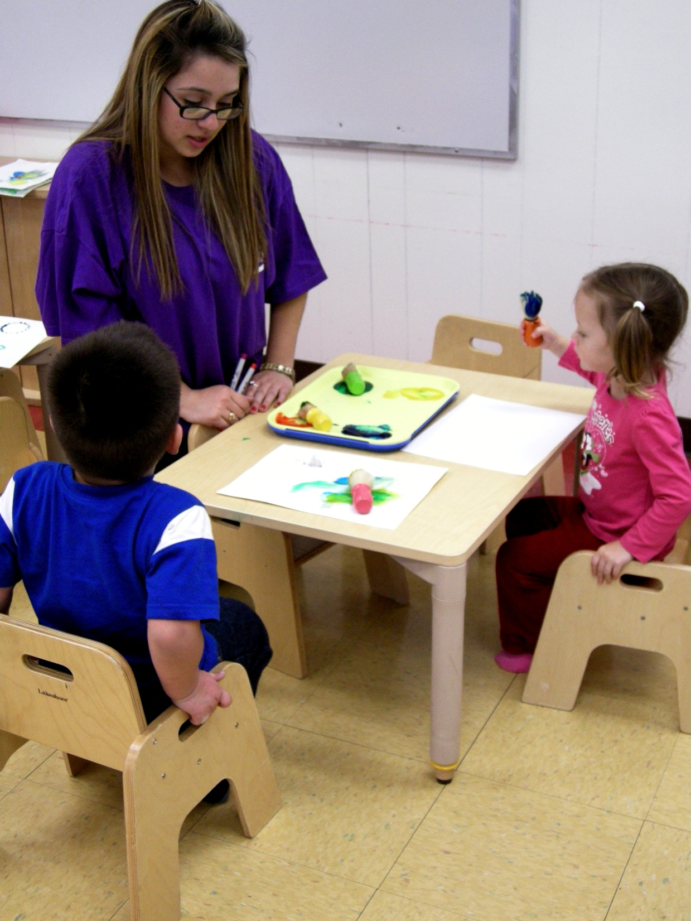
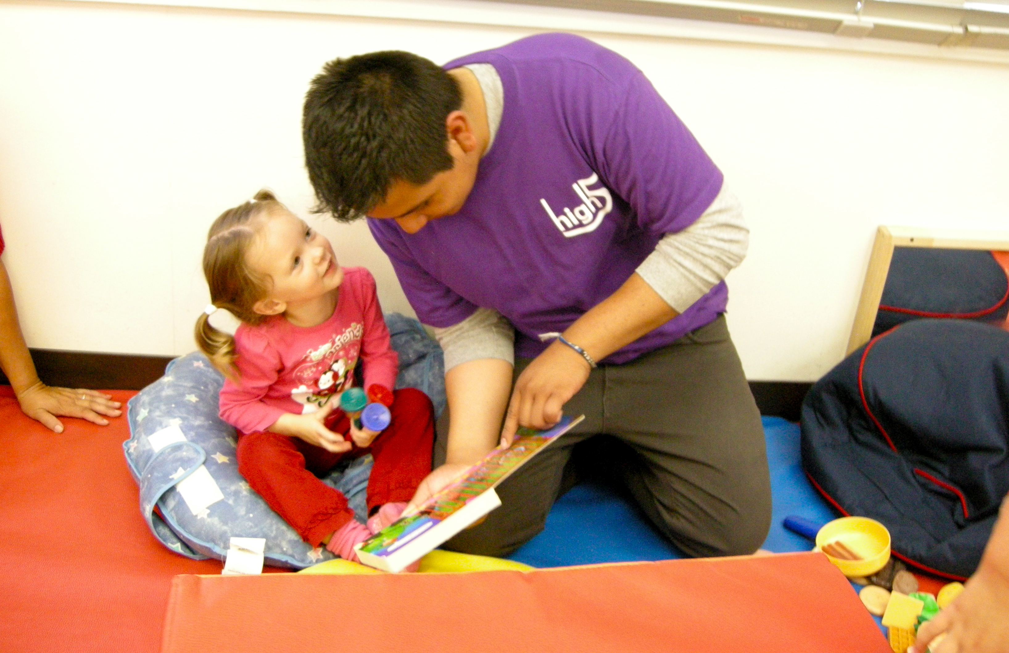
Step 6 – Implementation
Internships & Job Shadowing

Slide 38

Step 6 – Implementation
Program of Study
We are developing a pathway of 2-3 sequential Ch Dev courses, at each high school, that begins with an introductory-level class and ends in a capstone course. Dual credit (high school and college) may be possible.
To view a sample curriculum model for child development, or other industries, visit:
http://www.cteonline.org/

Slide 39
Step 7 – Evaluate
What have we learned so far?
Child Development Pathway Consortium

Slide 40
Contact Us:
Laurie Nalepa
Los Angeles Valley College
Dean of Vocational Education
nalepal@lavc.edu
Marni Roosevelt
CDPC Project Director
Director, LAVC Family Resource Center
roosevm@lavc.edu
Nona Matatova
Career & Technical Education Director
mataton@lavc.edu

