Slide 1
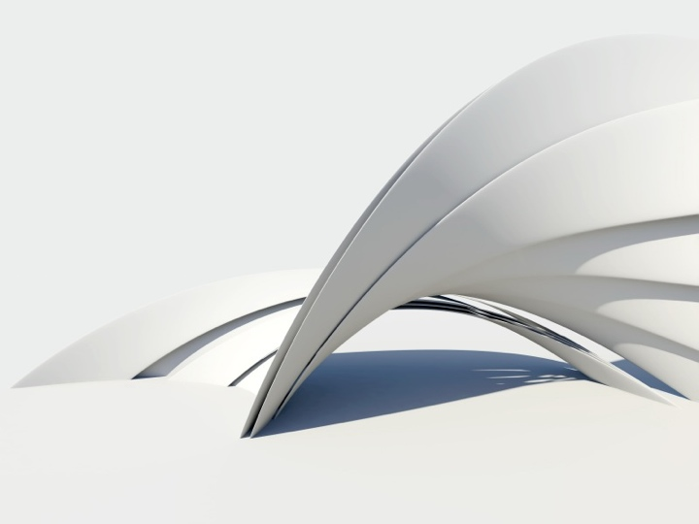
PRODUCT DESIGN – CONCEPTUALIZING THE FUTURE
Presented by:
Jillian Johnson-Sharp
Jean Gaudreau
Cesar Villalobos
1
Notes:
Good Morning. Thank you for coming to our presentation. Product Design - Conceptualizing the future.
Start with introductions: self, Jean, Cesar

Slide 2
OBJECTIVES
Define
Product Design and its importance
Describe
Vision for high school/post secondary
Explain
SB70 Community Collaborative WIP Grant
Inform
Program requirements
Inspire
Student outcomes and potential
2
Notes:
It’s always good to have objectives - to keep you on target
(Go through list)
And to start with our first objective - a quick video we put together on Design

Slide 3
3

Slide 4
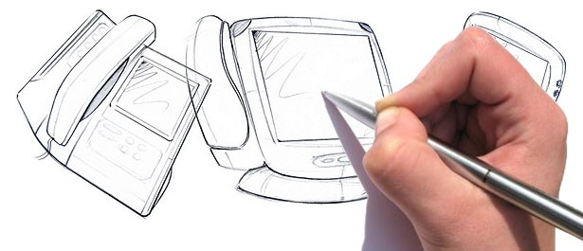
WHY DESIGN?
“… Mastery of Design …and other “soft” aptitudes is now the main way for individuals and firms to stand out in a crowded marketplace”.
Daniel Pink
Notes:
Why Design? - Read Quote
This quote from Daniel Pink’s “A Whole New Mind” expressed the importance of design not only for both individuals and businesses across the US,
but as an imperative for America if we are going to be able compete in this new global economy.

Slide 5
WHY DESIGN?
Design Thinking
Problem Solving
Futuristic Vision
Ideas to Reality
Faster
Cheaper
Better
For us
And for the planet!
5
Notes:
Pink talked about “soft” aptitudes, but there’s actually nothing SOFT about Design. Especially when we look at the “HARD” facts of retaining global competitiveness in the 21st Century.
The application of Design thinking, with its critical elements of research, ideation, visualization, creation and implementation has some extremely “SOLID” outcomes in every type of business and industry.
The ability to analyze a problem, and provide a solution.
To identify a need– escape/TRASCEND the boundaries and restrictions of of conventional wisdom, and Visualize the Future.
Not only Visualize it – but make it happen. Create it! NOW! Faster and Cheaper – Better …. Both for us, and for the planet!

Slide 6
THE VISION
Business Community/Industry Advisors
Post-secondary institutions
Public/Private
Colleges/Universities
Product Design Studio Course
Conceptual experiences
Hands-on experiences
From Idea to Reality ……!
6
Notes:
So - can we teach this? And if so, where do we start?
First we talked to our Industry Advisors to determine their needs
Then we approached post-secondary institutions see what programs they offered, and the potential for collaboration
From that, we established our Vision of creating a Product Design Studio Course for our high school students that would introduce them to the design process through a variety of conceptual and hands-on experiences.

Slide 7
SB70 COMMUNITY COLLABORATIVE WIP GRANT
Rancho Santiago Community College District
Partner in activities
High School/CTE Teachers
College Faculty
Train teachers
Purchase materials and equipment
Develop course content
Design modules in existing courses
Product Design Studio course
7
Notes:
That was our Idea and our Vision. And this is what made it possible.! The SB70 Workforce Collaborative WIP Grant.
- The Rancho Santiago Community College District gave us the opportunity of partnering with them on the Workforce Innovation portion of their SB70 grant.
- The grant allowed us to plan joint activities for High School District/CTE & ROP Teachers & Faculty from both Public and Private colleges
- Provide instruction, support and training for teachers
- Purchase necessary materials and equipment
- Develop two types of course content - 1. Design modules and activities that could be integrated into existing courses, and 2. Create a New Product Design Studio for our Engineering and Design Pathway.
SEQUE TO JEAN

Slide 8
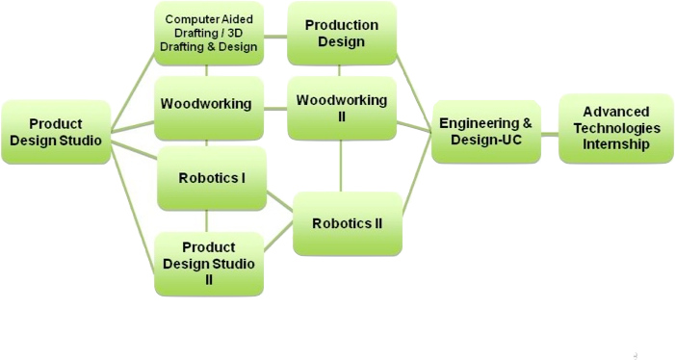
PATHWAY
Computer Aided Drafting / 3D Drafting & Design
Production Design
Wood Manufacturing I
Wood Manufacturing II
Advanced Technologies Internship
Product Design Studio I
Engineering & Design-UC
Robotics I
Robotics II
Product Design Studio II
8
Notes:
Here is the sequence of courses we developed for our Engineering and Design pathway. Our objective was to create a new learning landscape with Design as a core, central tool to engage students. The pathway serves students of all academic abilities. We have been able to articulate many of the courses in this pathway with post-secondary schools. Not all courses are offered on a campus, but it is a work in progress and a vision to offer as many as possible as we move forward.
As you see, we start the pathway with the Product Design Studio I course. We wanted to start out with a project-based course that is highly engaging and offers an antidote to boring rigid verbal instruction that some schools are plagued by. Product Design Studio I offers a sampling of some of the competencies taught in other courses, and prepares students to be successful in the other pathway courses. I’ll tell you more about this course later in this presentation.
Next, you see a series of full year courses. Although CAD is a half year course, it is a pre-requisite for our 3D Drafting and Design course. PD II has a pre-requisite of PD I. Both Robotics and PD II incorporate Solidworks in them as well as an optional module of Rapid Prototype Additive Manufacturing (RPAM). So, depending on a student’s interest, they can move in many directions.
The next level of courses continues to build on student interest in specific areas. We developed a “Production Design” course which introduces students to materials and manufacturing processes. The Orange County Dept. of Ed. took the Production Design course online for a charter school course offering.
We knew that it would be important to have a UC approved course in this pathway. We received ‘g’ elective credit for the “Engineering and Design” course. This course requires junior or senior standing, Algebra I and a year of lab science as prerequisites. It is a survey course of mechanical, electrical, civil and aeronautical engineering. We also included ‘green” topics and infused the design process into the entire course. Students in this course also use Solidworks and it has an optional module of RPAM. It is definitely not rooted in the age-old egg drop contest, rocket launch, and bridge building projects.
Our vision for the next step is to create a capstone course where students are able to have an internship experience in Advanced Technologies. We area also working on developing engineering camps and clubs for our middle schools students so we have an interested pipeline of incoming students.

Slide 9
PRODUCT DESIGN STUDIO-I
Fall 2010
Course Format
180 hrs
STEAM-Standards based
Project-based
Studio projects in multiple materials/process
Rooted in the Design Process
9
Notes:
As you saw in the previous slide, we begin the pathway with the Product Design Studio I course which we offered for the first time last fall. We feel this course is the catalyst to engaging students and giving them a fresh perspective and a new way to think.
This is 180 hr year-long course currently offered within the regular school day.
This course is a perfect example of STEAM – students learn both CTE and Academic standards in science, technology, engineering, arts, and math
SInce this is an introductory course, it was necessary to plan the students’ projects so that they would access all of the materials and technology. So we developed a number of Hands-on Common Projects with step by step instructions and evaluation rubrics
These Projects involve a variety of materials, processes, equipment and technology including:
Sketching
Foam sculpting
Speedforming
Vacuforming
Wood working
Metal bending
Engraving
Painting and finishing
To engage our students
Throughout the entire course students are learning about and applying the Design Process

Slide 10
DESIGN PROCESS
Concept Generation:
Concept Evaluation
Prototype Fabrication
Research
Design Brief
Concept Sketches
Critique
Refine
10
Notes:
When we were developing the Product Design Studio courses we consulted Industrial Designers, and several post-secondary design programs. They all told us that our program needed to be firmly rooted in the Design Process. This helps the student to problem-solve and develop unique solutions to design problems.
So what is the Design Process?
It begins by researching a design problem and documenting multiple solutions and sketches.
Next they’ll refine their ideas as they go along through peer & industry critiques.
And lastly, they fabricate a final product.

Slide 11
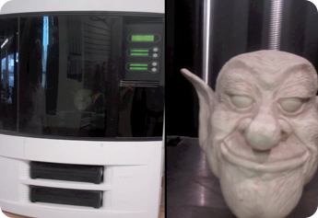
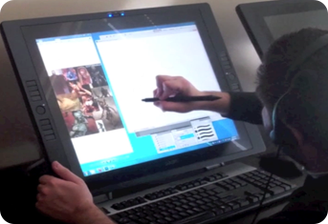
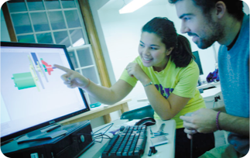
PRODUCT DESIGN STUDIO-II
Fall 2011
Design Teams
Advanced real-world design briefs:
Green design
Universal design
Advanced Skills:
Sketching/Rendering/Rapid Visualization
Prototype Building
Presentation & Critiques
CAD
RPAM
Joint projects with colleges and industry
11
Notes:
Because of the success of this first course, we are currently planning a second level Product Design II course for Fall 2011.
Again, using input from high school instructors, post-secondary faculty, and industrial designers, we are expanding the student experiences to include:
More teamwork and responses to advanced design briefs that include green projects and universal design
Student will advance their skills in sketching, rendering, and rapid visualization techniques, as well as prototype building.
Also, a very important aspect of the course is building students communication skills through presentations and critiques.
In this second level course, students will be learning CAD so that they can take their sketches from paper to the computer with Solidworks
We’ve also included an optional module of RPAM for those classrooms that have an RP printer.
A very important aspect of the second level course is that students will be working on joint projects with local colleges and industry

Slide 12
CCROP PRODUCT DESIGN STUDIO I
INITIAL SET-UP
Environment
Studio/Shop
Task appropriate work stations
Display Area
Tools & Equipment
Materials & Supplies
Sketching paper/books
Sketching pens
Foam
Spray paint
Arcylic Sheets
Product Design Studio II
Computers for CAD
Solidworks
RPAM
Wood working equipment
Vacuforming
Acrylic Bending
Metal Bending
Laser Engraving
12
Notes:
So, at this point, I’m sure that one of your questions is what does it take to set up this course …
First you need an appropriate environment – which we know is hard to find on a high school campus. What we found when we visited design studios was that high school students really need a new perspective in the way they teach technology. Technology needs to be integrated with design experiences. We need to infuse more critical and creative design studio thinking process. The idea is Design, Engage, Build, and Tranforms. You want a space that says “creativity” and has work stations and display areas for teams to design and create.
You’ll want to set up your studio with some basic tools and equipment such as: (LIST)
Some of the materials and supplies you’ll need are: (LIST)
For Product Design Studio II we are adding a bank of computers with Solidworks loaded. As an option, you can add a 3D printer

Slide 13
ISSUES AND CHALLENGES
Budget
SB70 Grant Partnerships
On-going sustainability
Creative space
Teacher
Training
Marketing to Students
13
Notes:
Because of the Budget Challenges which will in all probability will continue for the foreseeable future - it was important to consider the start up and on-going costs of the course and to identify ways of alleviating some of these costs.
Receiving an SB70 grant was vitally important to starting this project. It has enabled us to purchase a variety of Tools, Equipment and Materials.
It also provided funds for us to hire an Industrial Design consultant for teacher training and project development.
Through the grant, we purchased a laser engraving machine which we will be using to generate revenue for the program. Various items will be designed by students, engraved and sold.
With the assistance of a variety of funding sources from the District/ ROP/CTE/School/ and CCROP Grant – we have gradually been able to convert an old welding shop at Bolsa Grande HS into a working design studio with work stations and display areas.
Also, foam for the sculpting projects can be costly so we solicited and received a large donation of foam material
Another issue is who can teach this course? An ideal teacher for the Product Design Studio course is someone who has a background in Industrial Design, industrial technology, or someone with a CAD or Engineering background. .
Teachers will need to be trained in sketching, foam sculpting and operation of the various pieces of equipment such as the vacuform machine, laser engraver, CAD software, and the RP printer.
Another challenge is the marketing and recruiting of students. We are developing brochures and posters that are geared toward our student audience. However, word of mouth seems to be helping because we are hearing that we’ll have a full class for Product Design Studio II.

Slide 14
OUTCOMES FOR STUDENTS
Engaging, Relevant and Rigorous curriculum
Integrated academics in STEAM
Work-based learning/internships
Articulation/Dual credit
Multiple exit points for certificate and degrees
High wage - High Demand Careers
Product Design
Architecture
Toy Design
Engineering
Automotive Design
Computer Modeling
Digital Illustration
Model Making
Drafting
Entertainment Design
Ergonomics
Green Technologies
Advanced Manufacturing
UCI- Irvine Preferential Admissions
14
Notes:
Ultimately, it’s all about the students! What are the outcomes for them – and how are we preparing them to compete in the global marketplace?
First and foremost, we revamped our entire curriculum in this pathway and wrote new courses or revised existing competencies.
STEAM, became the common thread in this pathway particularly with the art piece through sketching, CAD, and RPAM becoming the “hook” that helps our teachers integrate the science, technology and math in a very fun and engaging way.
With our industry and post-secondary partners, we are putting together experiences for our students that show them the application of what they are learning
Articulation/Dual Credit was a goal for us to make sure that all courses in this pathway were aligned or articulated. We have been able to get agreements signed with multiple post secondary schools. However, it doesn’t end there. We consider these schools our partners and continue to work with them to coordinate joint activities for our students and teachers.
As we all know, not every student in a pathway like this will go on to become an engineer. We’ve been able to identify multiple exit points that lead to high-wage, high demand careers. Our teachers help students understand their options for post-secondary certificate programs, AA degrees as well as BA programs that this pathway leads into.
Industry is saying that they want us to train students to be “holistic”. They want to hire students that have wide & varied Design and technology experiences. They don’t want students who are proficient in a particular software or certain piece of machinery. They want students who they can assign to work in a variety of teams to solve design problems and have had the “hands-on” technology experience to know that their solutions work.
The end result is high wage- high demand careers, such as you see here.
One of our partners is the Henry Samueli School of Engineering at UC Irvine. Through a joint project, we’ve established a “preferential admissions program.” They recognize the value in a high school student taking courses in this pathway. They tell us that it’s important for students to learn the theory and take courses like AP Physics and Calculus, but it’s equally important for the student to experience hands-on projects that show them the application of the academics. The Engineering Admissions department will give more weight to an application that includes a course or courses in our pathway, with all other criteria being met. That has been a huge leap forward for ROP/CTE credibility!!

Slide 15
DO WE HAVE TO BE ARTISTS?
“We may not all be Dali or Degas. But today we must all be designers.”
Daniel Pink
15
Notes:
JILLIAN
These opportunities & outcomes are available for all students
So what skills and talents do they have to have in order to be successful?
One of the main questions is : that in order To be successful in “Design” - does everyone have to be an artist?
According to Pink - Read Quote:
– Can anyone design – can anyone sketch?
Well – obviously there are those among us who have definite and major talents in the areas that we would formally call “Art”. However, that does not mean that the rest of us – are excluded or eliminated from the “Design” field.
As we said earlier – Designing is the ability to problem solve, to respond to a need, adapt and perhaps retrofit an existing object, make an object in more eco-friendly and sustainable ways.
Design thinking and design concepts can be expressed in a variety of ways – only one of which is what we might be conventional “Art”.
However, the ability to document your thoughts and ideas is a VITAL part of the design process.
So – although we don’t all need to be artists, we do all need to be able to create quick sketches that visually express and communicate our ideas.
Fortunately basic sketching can be taught.

Slide 16
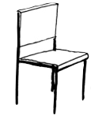
SKETCHING ACTIVITY
Teacher Training
Rapid Visualization
Sketching Techniques
Lines
Basic Shapes
Perspective/Shading
Student Training
Techniques
Practice
Projects
Notes:
JILLIAN
With the help of the grant and some of our valued partners we were able to provide some basic training for our instructors. We are extremely grateful to the Art Institute of Orange County, who provided free training sessions in Rapid Visualization and sketching techniques.
They learned how to look at things, to develop a visual eye. They learned about lines, basic shapes, perspective, and shading and performed basic exercises that allowed them to quickly create rough sketches of real world objects.
Yes - this is something that can be taught.
Cesar Villalobos has been teaching the basics to his students
And now he’s going to teach you!

Slide 17
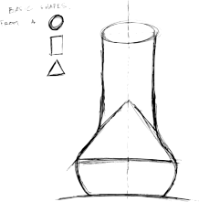
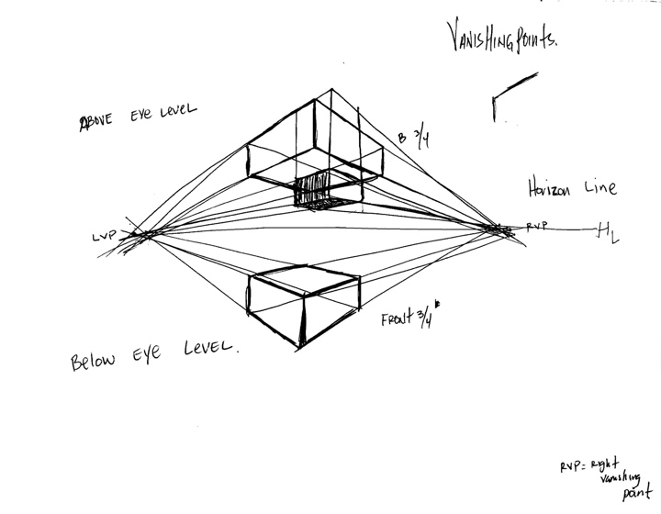
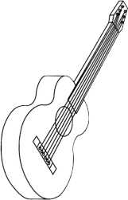
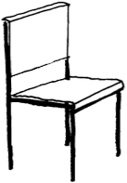
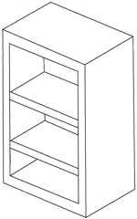
SKETCHING ACTIVITY
Basic shapes
Real world objects
Perspective
17

Slide 18
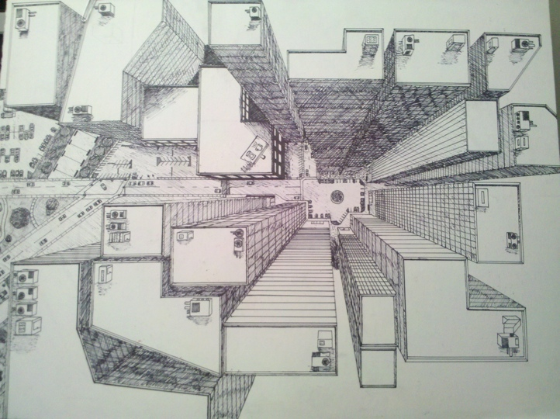
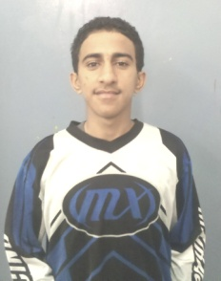
Assaf Ghalib, 12th Grade
First Semester Student in Product Design Studio I

Slide 19
“College and Career Ready”
19
Notes:
Hopefully we INSPIRED you to consider how a program such as this - teaching Design and Design Thinking to ALL STUDENTS - can have applications and relevancy in every academic discipline. It transforms the educational experience by engaging active learning. Driving the creative capital that the global market now demands.

Slide 20
“By taking this class I have realized that I have become more efficient and confident to be more independent and I can accomplish things on my own.”
Assaf Ghalib, 12th Grade

Slide 21
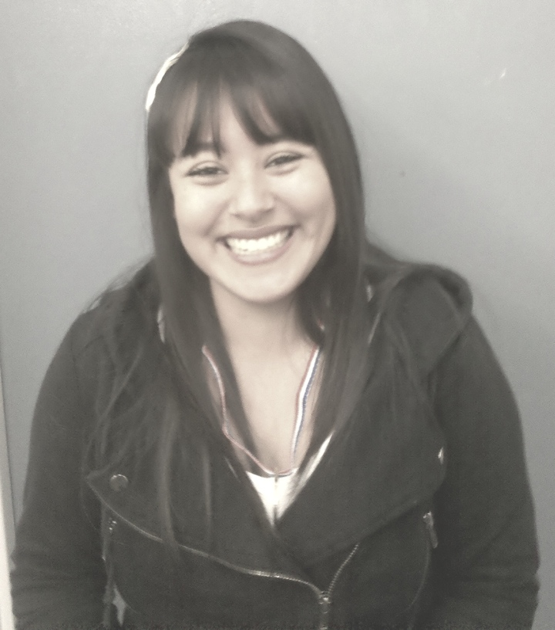
“This class has been beneficial to me because I did not know what I wanted to do with my life, but now I know I want to major in this profession.”
Ana Piza, 12th Grade

Slide 22
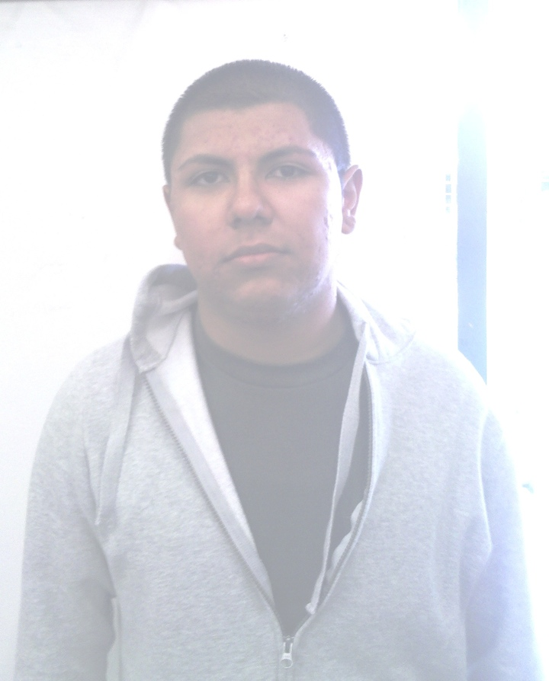
“Mr. Villalobos has motivated me to broaden my perspective and further my education in Product Design...I can see myself doing this for a living."
Alejandro Bustos, 10th Grade

Slide 23
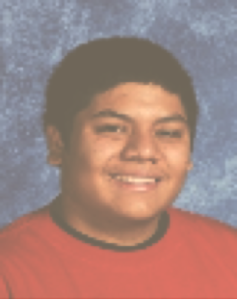
“I hope to continue my studies in this field learning more about Design, Solidworks, Robotics, and Rapid Prototyping.”
Isual Delarosa, 11th Grade

Slide 24
“Design makes the youth the biggest asset and untapped resource for imagining a new future.”
Emily Pilloton, Project H Design
Design: a new tool to engage students
Notes:
It’s ultimately about the students! Here is a snapshot of some of our students inspired by our courses.
Finally to end, a quote by Emily Pilloton at the TED conference.
Read quote final quote.

Slide 25
SAMPLE OUTPUT
Jillian Johnson-Sharp Coordinator - Curriculum & Instruction Orange County Department of Education Central County ROP/CTE JJohnson-Sharp@ocde.us | Jean Gaudreau Curriculum Specialist/Articulation Coordinator Orange County Department of Education Central County ROP/CTE JGaudreau@ocde.us
Questions/Comments:
25

